Slide 1
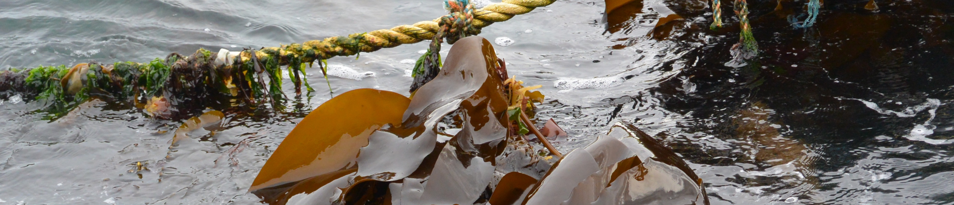


The seaweed industry in the UK & Cefas role
Colour | Hex code
 | CCEAF2
 | B2CCD3
 | 83B4C0
 | 57D5FF
 | 48C0EC
 | 00C3F8
 | 00B2E1
 | 007493
 | 005166
 | 000A2E
Elisa
Capuzzo
Senior Ecosystem
Scientist

Slide 2
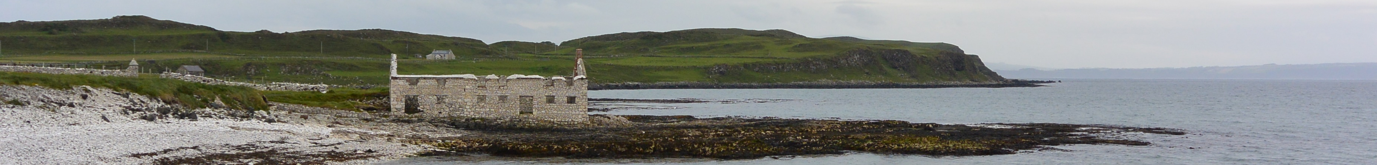
Seaweed industry in the UK
Resurgence in the last decade & development of seaweed aquaculture
Drivers:
Multiple uses and products
Bioremediation (N/C uptake), provision of habitat & nurseries, coastal protection
Low carbon footprint, no animal welfare concerns
Alternative livelihood, job opportunities, new value chains
Food / feed / soil enricher
Late 17th & 18th centuries
Soda ash for glass, soap production, linen bleaching
19th & early 20th centuries
Iodine extraction for tincture of iodine
20th century
Hydrocolloids production, gelling agent in food and non-food applications
elisa.capuzzo@cefas.co.uk
@dictioca

Slide 3
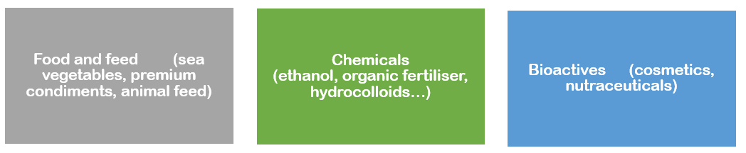

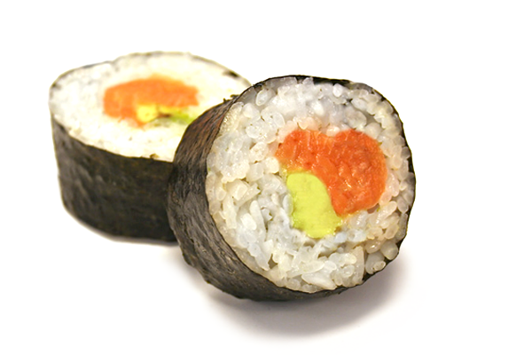
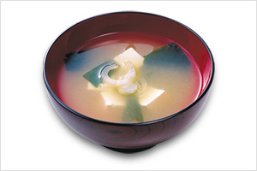
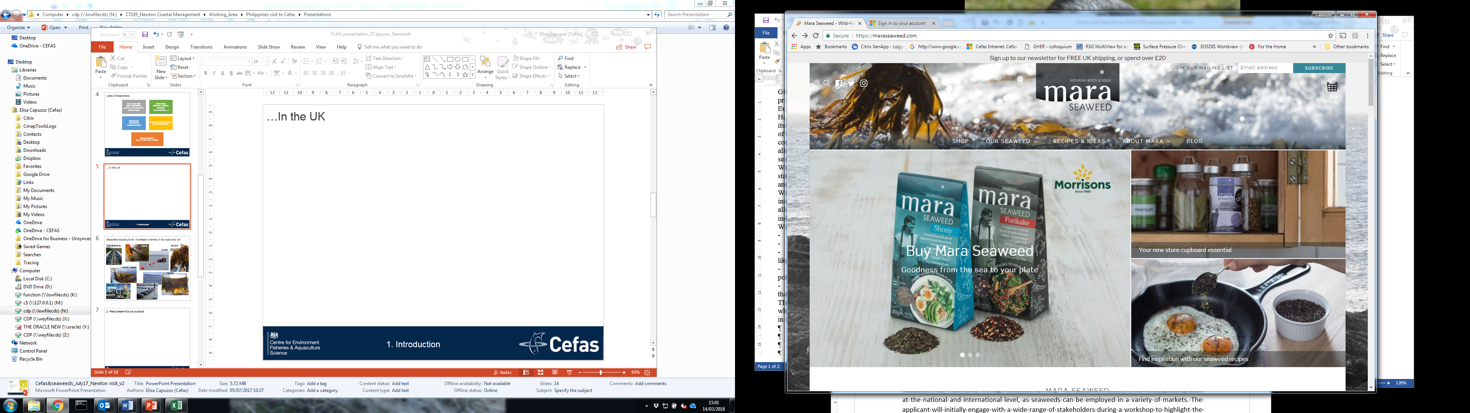
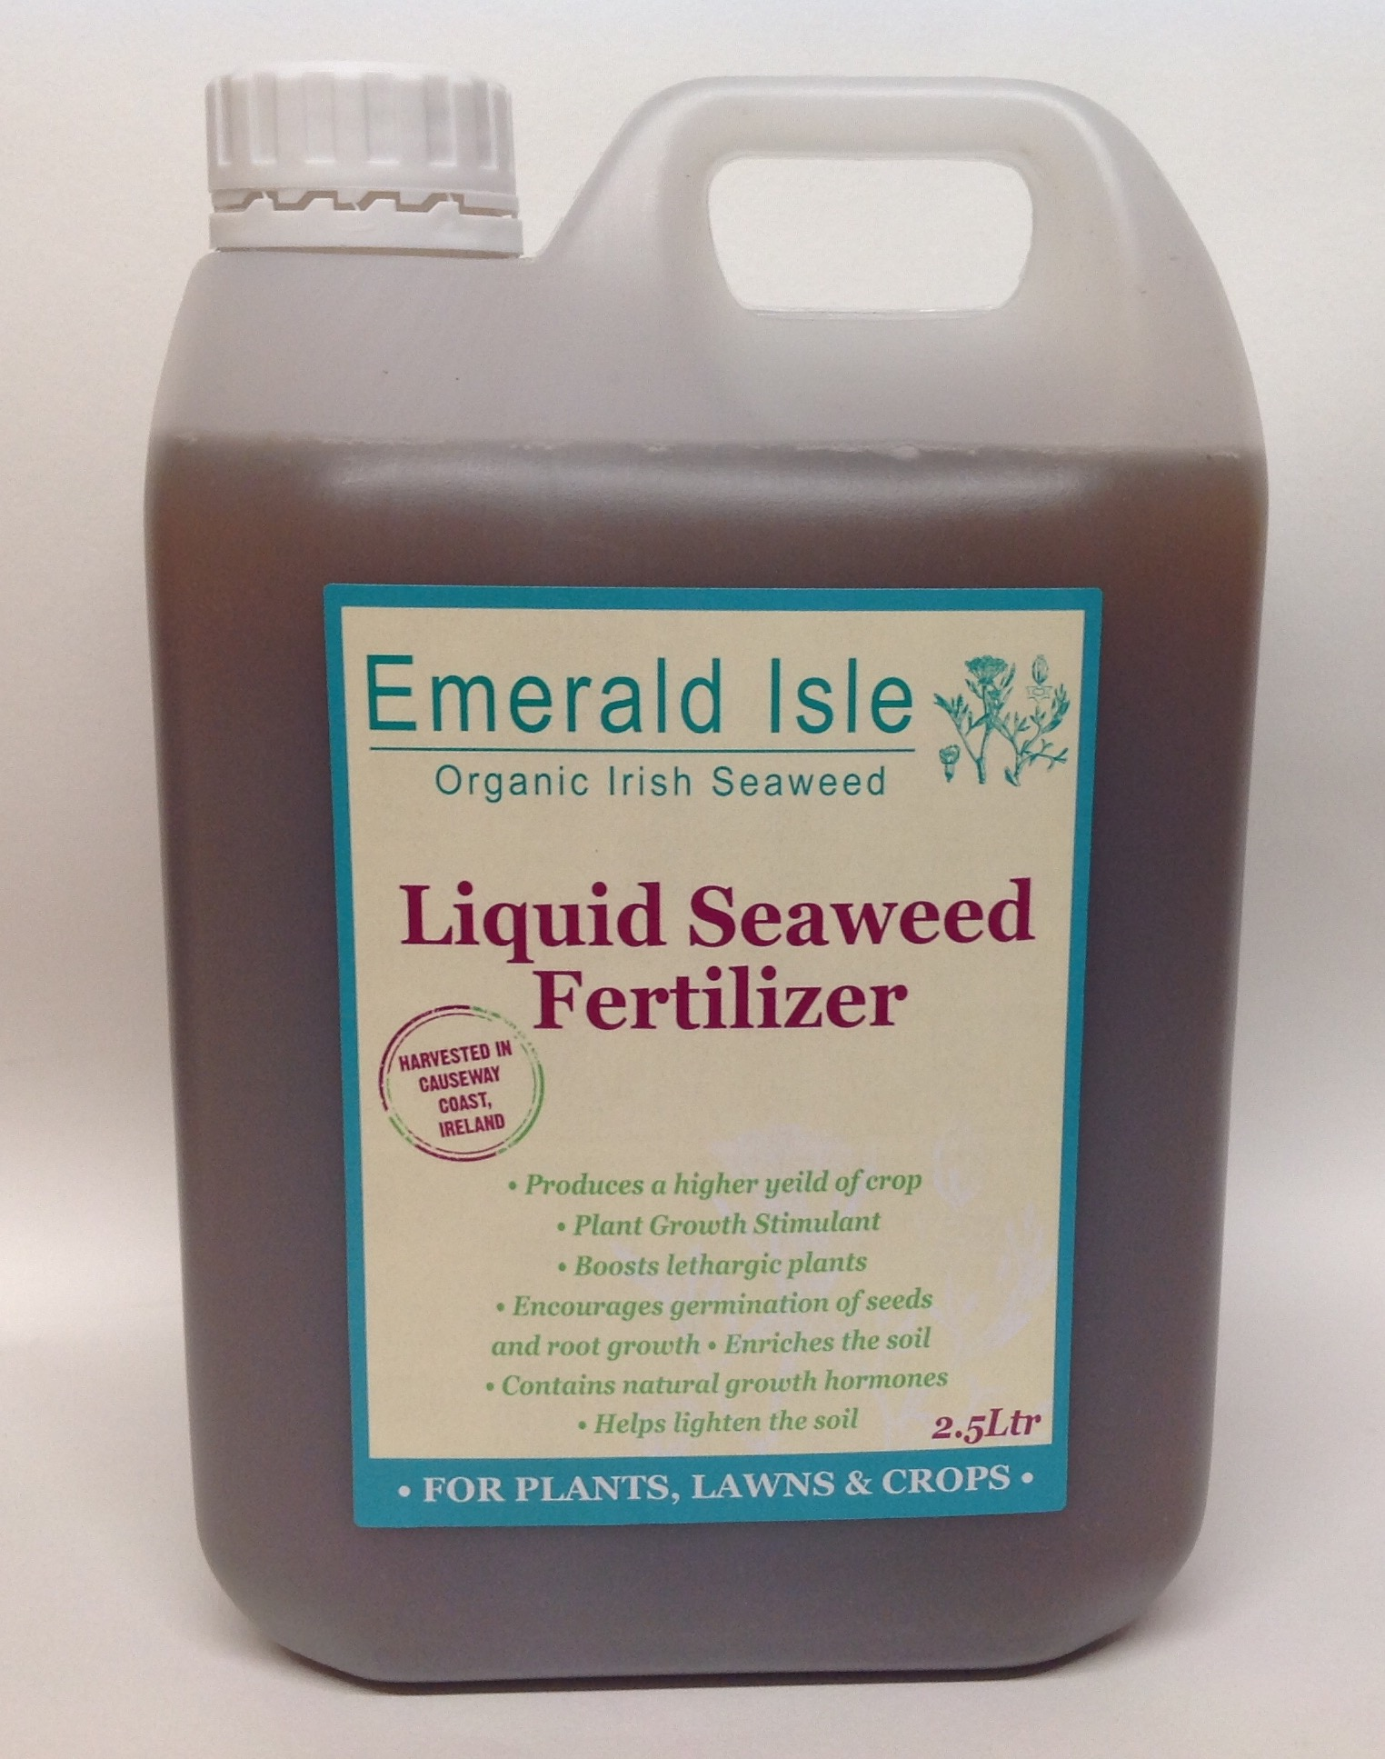
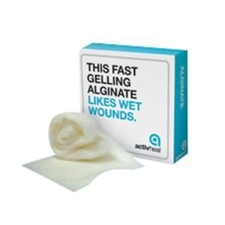
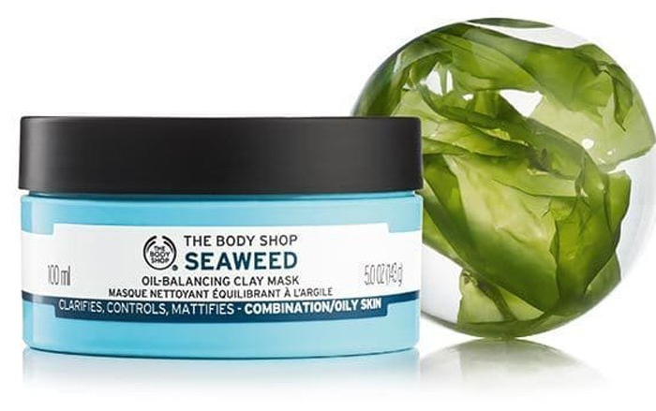
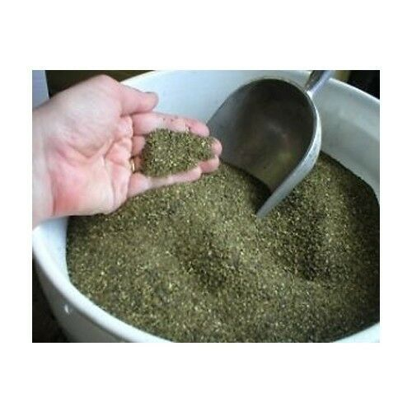
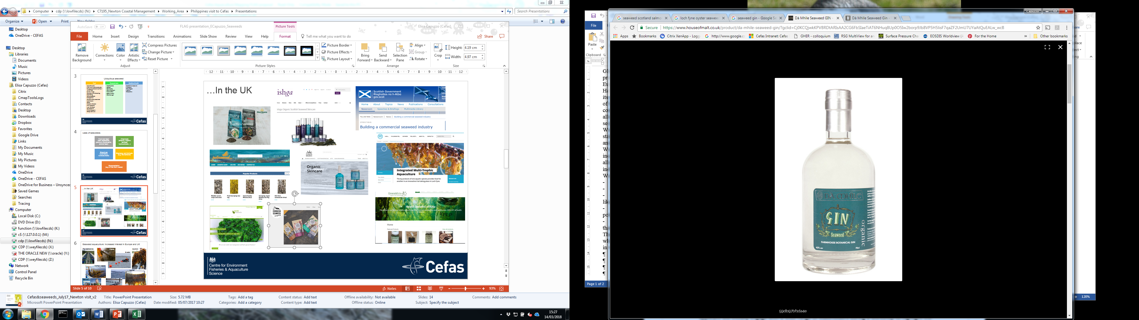
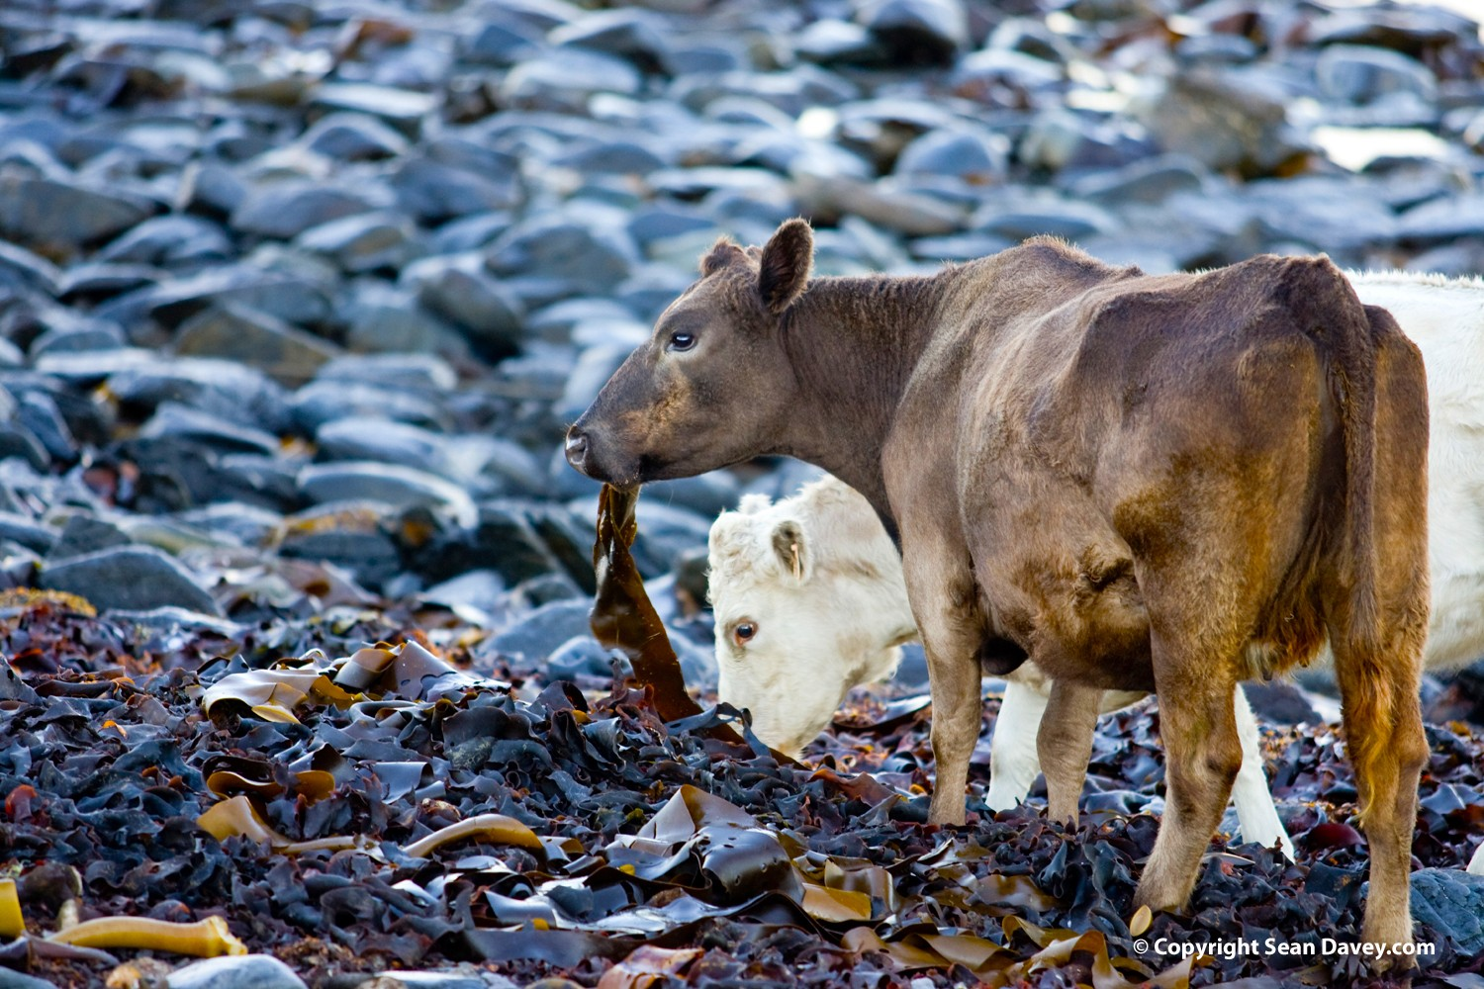
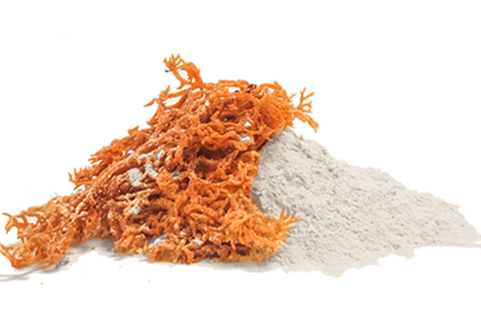

Uses of seaweed (1/2)
elisa.capuzzo@cefas.co.uk
@dictioca

Slide 4
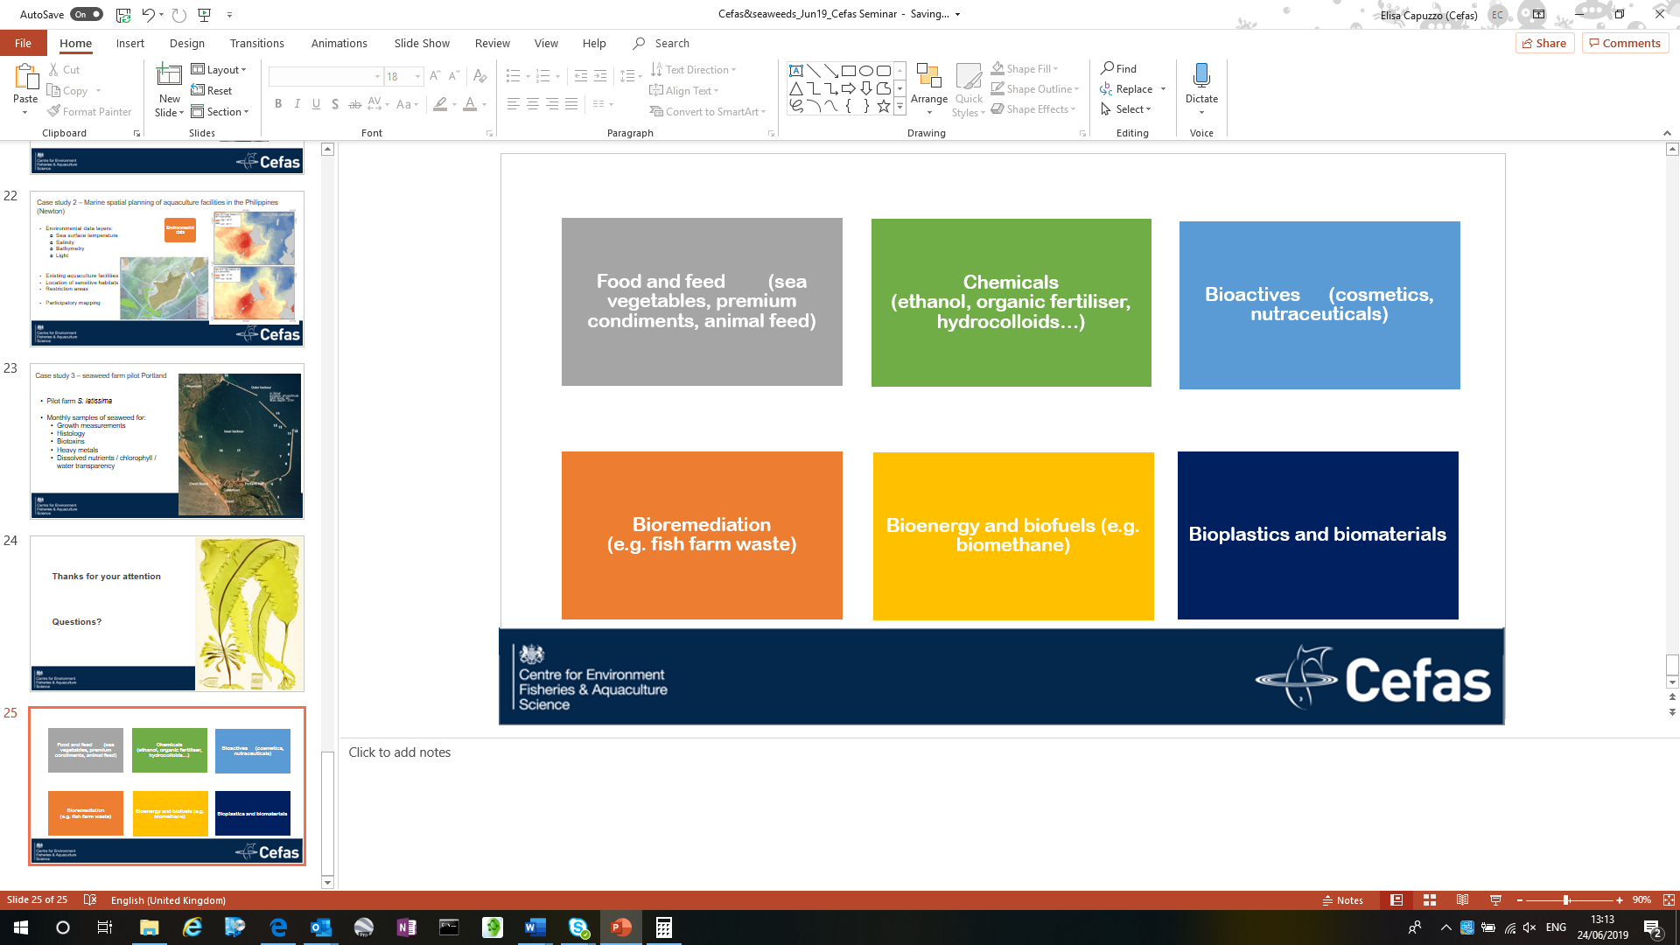
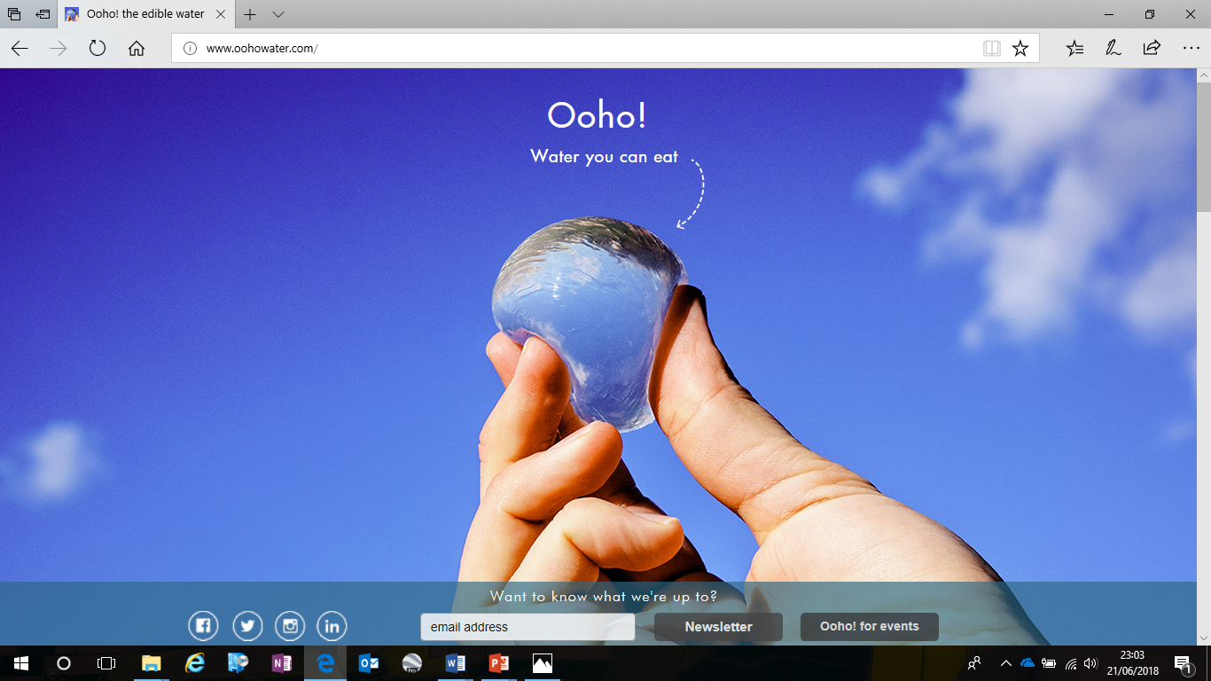
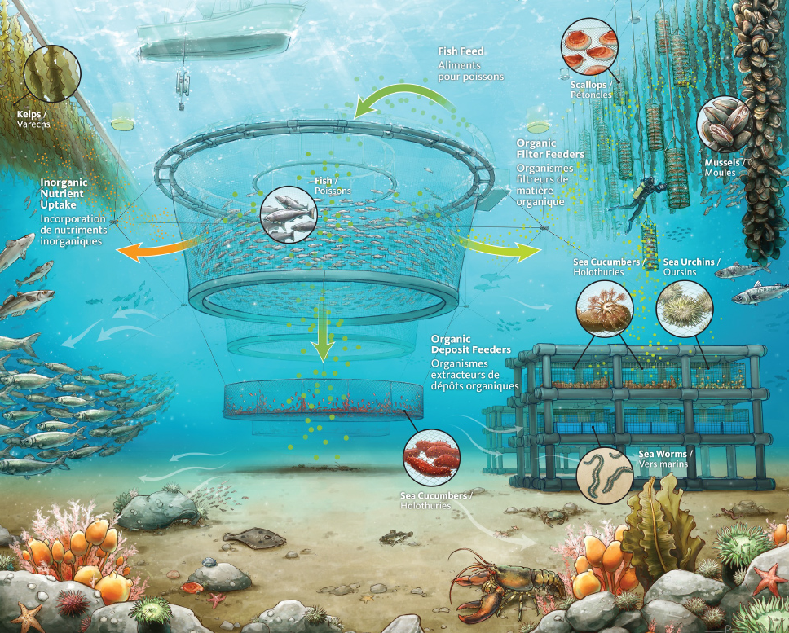
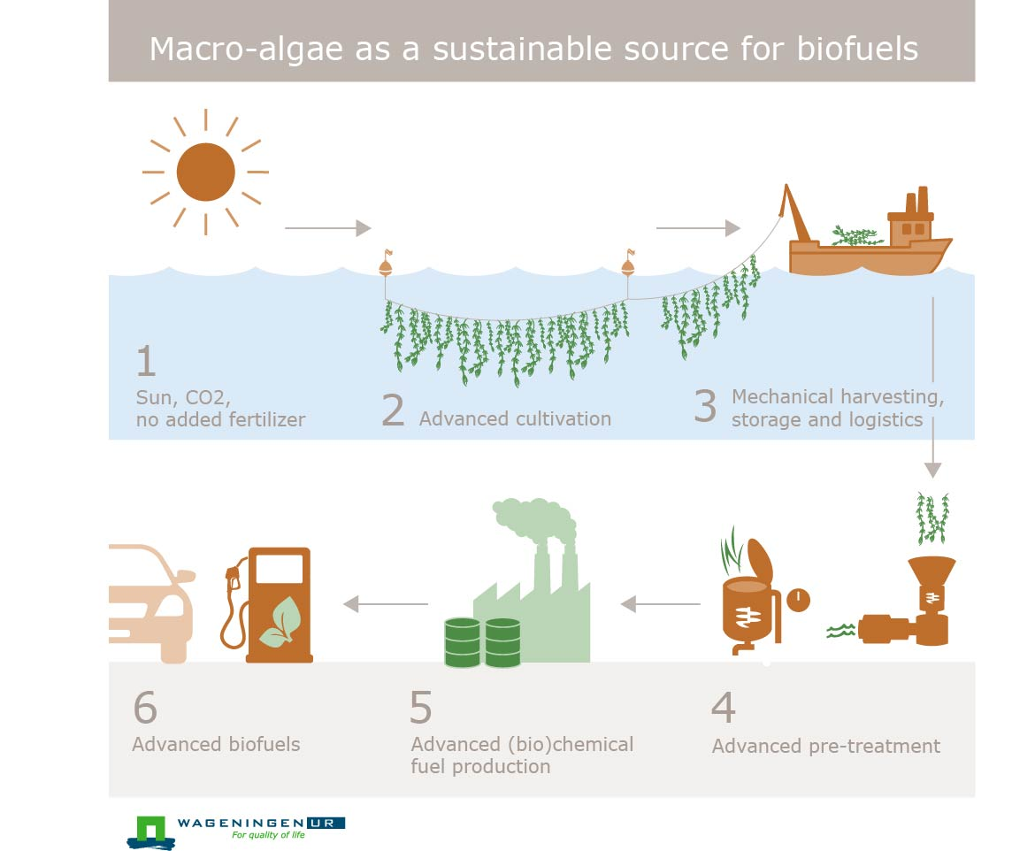
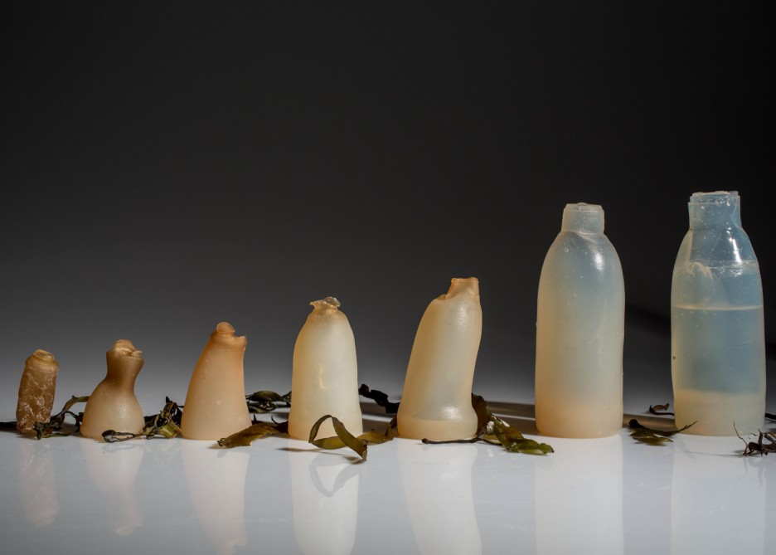
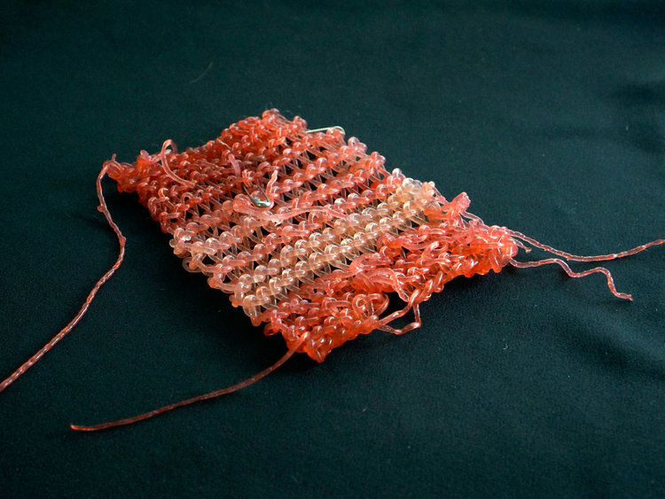
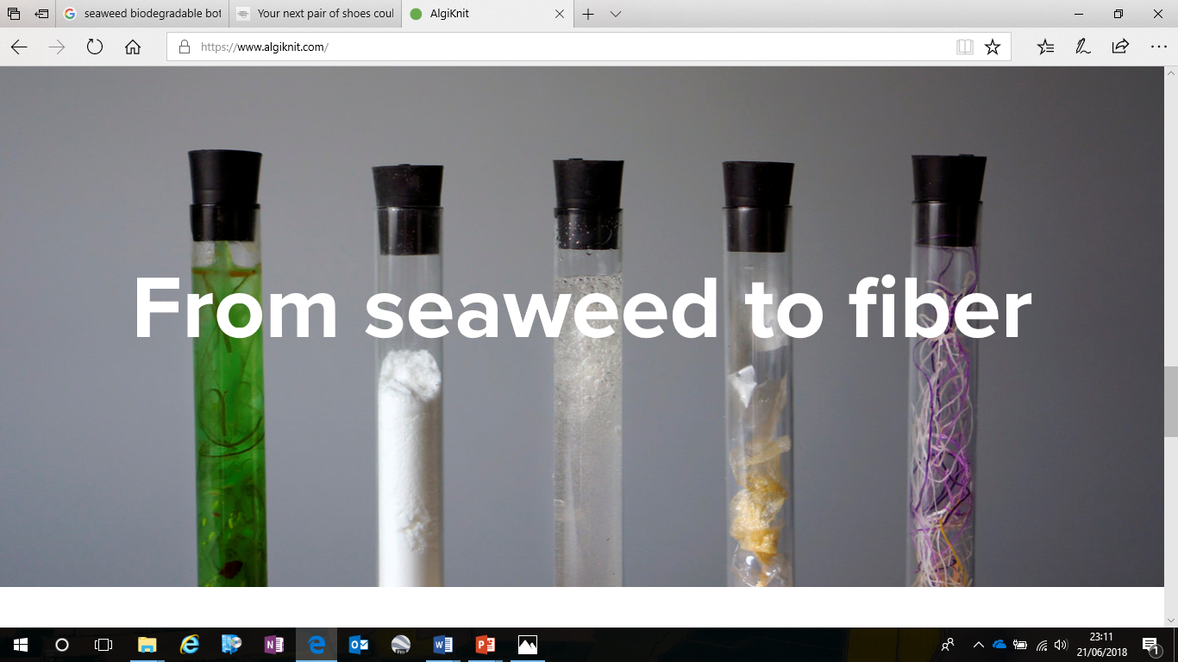
Uses of seaweed (2/2)
https://www.dfo-mpo.gc.ca/aquaculture/sci-res/imta-amti/index-eng.htm
elisa.capuzzo@cefas.co.uk
@dictioca

Slide 5
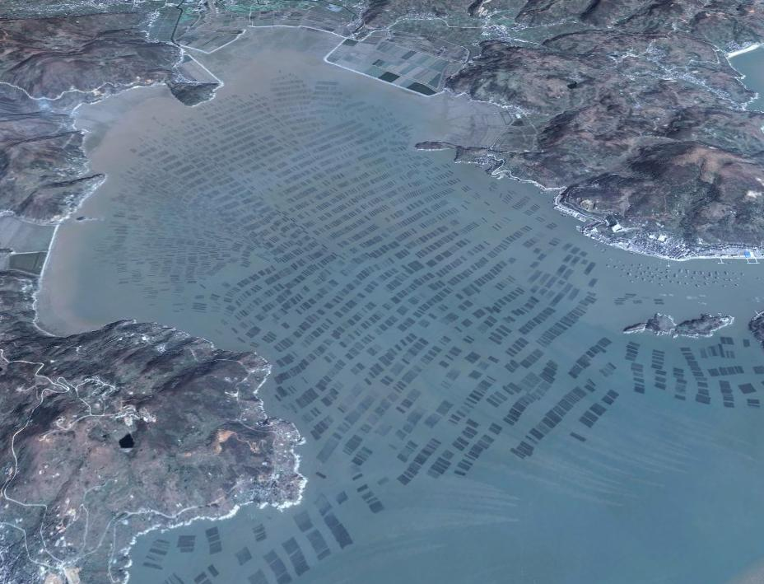
Global seaweed production
> 35 million tonnes of seaweed produced in 2020
Almost all from aquaculture sources
Main production from Asian countries (e.g. China, Indonesia)
Europe account for approx. 1% of global production (mainly from wild harvest)
elisa.capuzzo@cefas.co.uk
@dictioca

Slide 6
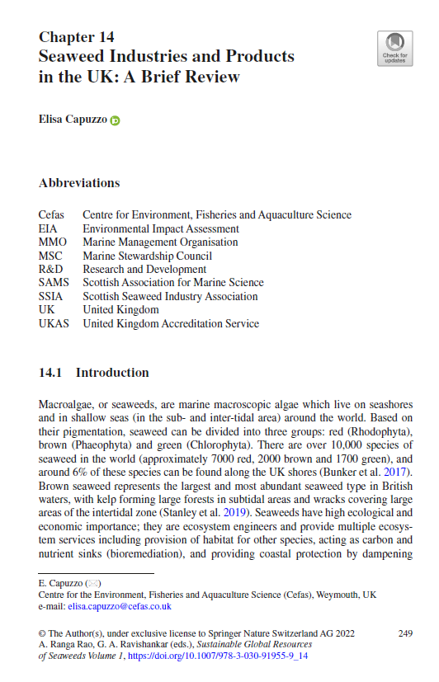
A developing industry in the UK – current status
14+ commercial seaweed farms + R&D
Platforms for seaweed (Scottish Seaweed Industry Association, The Seaweed Alliance, Algae-UK…) & part of national aquaculture strategies (Seafood 2040)
No records of national production
80+ seaweed-related businesses; food&drink and beauty most important sectors although there is an increased product/business diversification (e.g. bioplastics, biorefinery)
Knowledge gaps and barriers: technical, financial, environmental, market
https://link.springer.com/chapter/10.1007/978-3-030-91955-9_14
https://marinescience.blog.gov.uk/2022/05/05/the-developing-uk-seaweed-industry/
elisa.capuzzo@cefas.co.uk
@dictioca
Notes:
https://www.gov.uk/government/publications/the-seaweed-industry-in-the-uk-and-abroad
https://link.springer.com/chapter/10.1007/978-3-030-91955-9_14
https://marinescience.blog.gov.uk/2022/05/05/the-developing-uk-seaweed-industry/

Slide 7





How Cefas supports sustainable aquaculture
Environmental
Health
Social / Economic
Regulation & licensing
Site selection
Monitoring & modelling farm’s effects & yield
Food safety
Biosecurity
Understanding & surveillance of pathogens & emerging diseases
#OneHealthAquaculture
Stakeholders views & perceptions
Gender & equality socio-economic analysis
Feasibility studies
elisa.capuzzo@cefas.co.uk
@dictioca

Slide 8
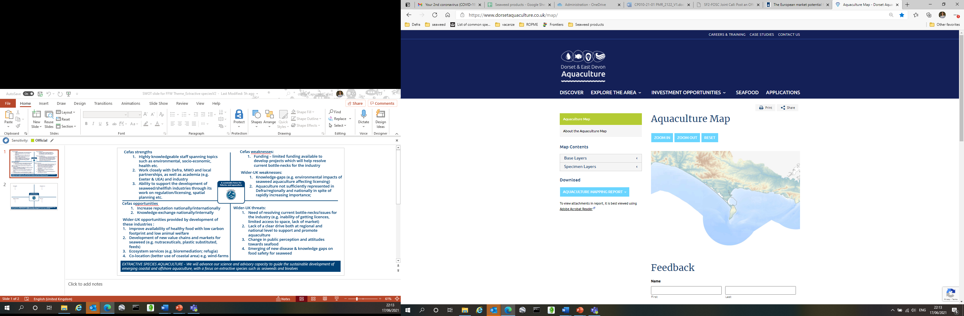
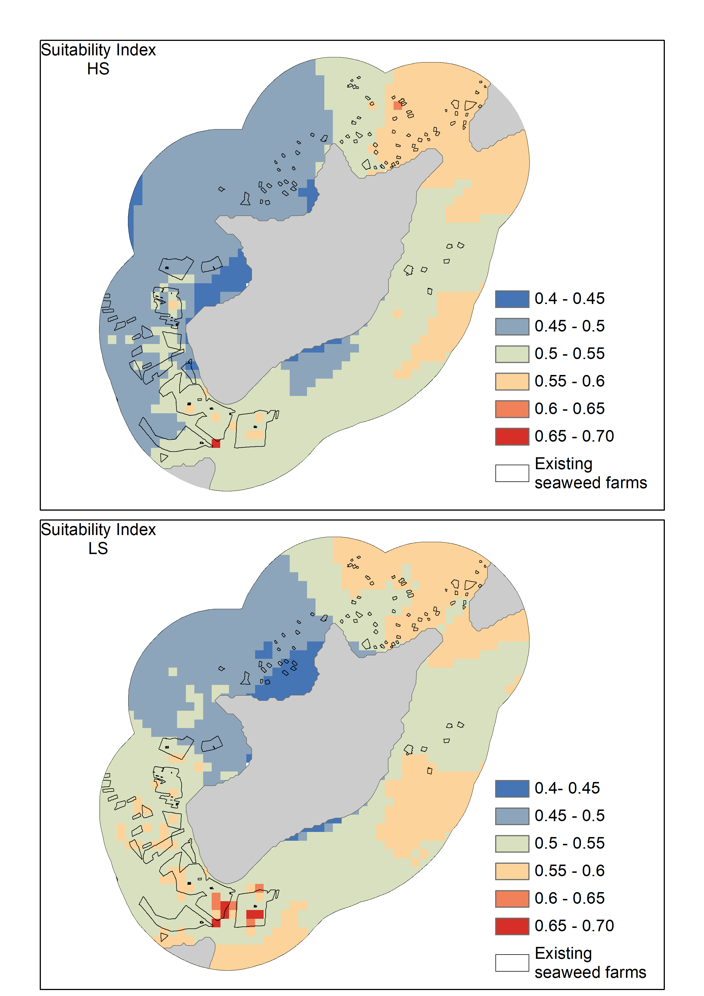




Mapping tools for coastal management & contingency planning
Identify suitable areas for seaweed, shellfish and/or finfish & utilised to guide spatial planning.
Applied at local and national scale, as well as internationally (e.g. Dorset, below, and Philippines, right).
GIS toolkit to identify suitable (seaweed) aquaculture production sites which maximize economic returns, while minimising environmental effects.
The tool kit used environmental and socio-economic data as well as constraints (e.g. other uses of the coast).
https://www.dorsetaquaculture.co.uk/map/

Slide 9
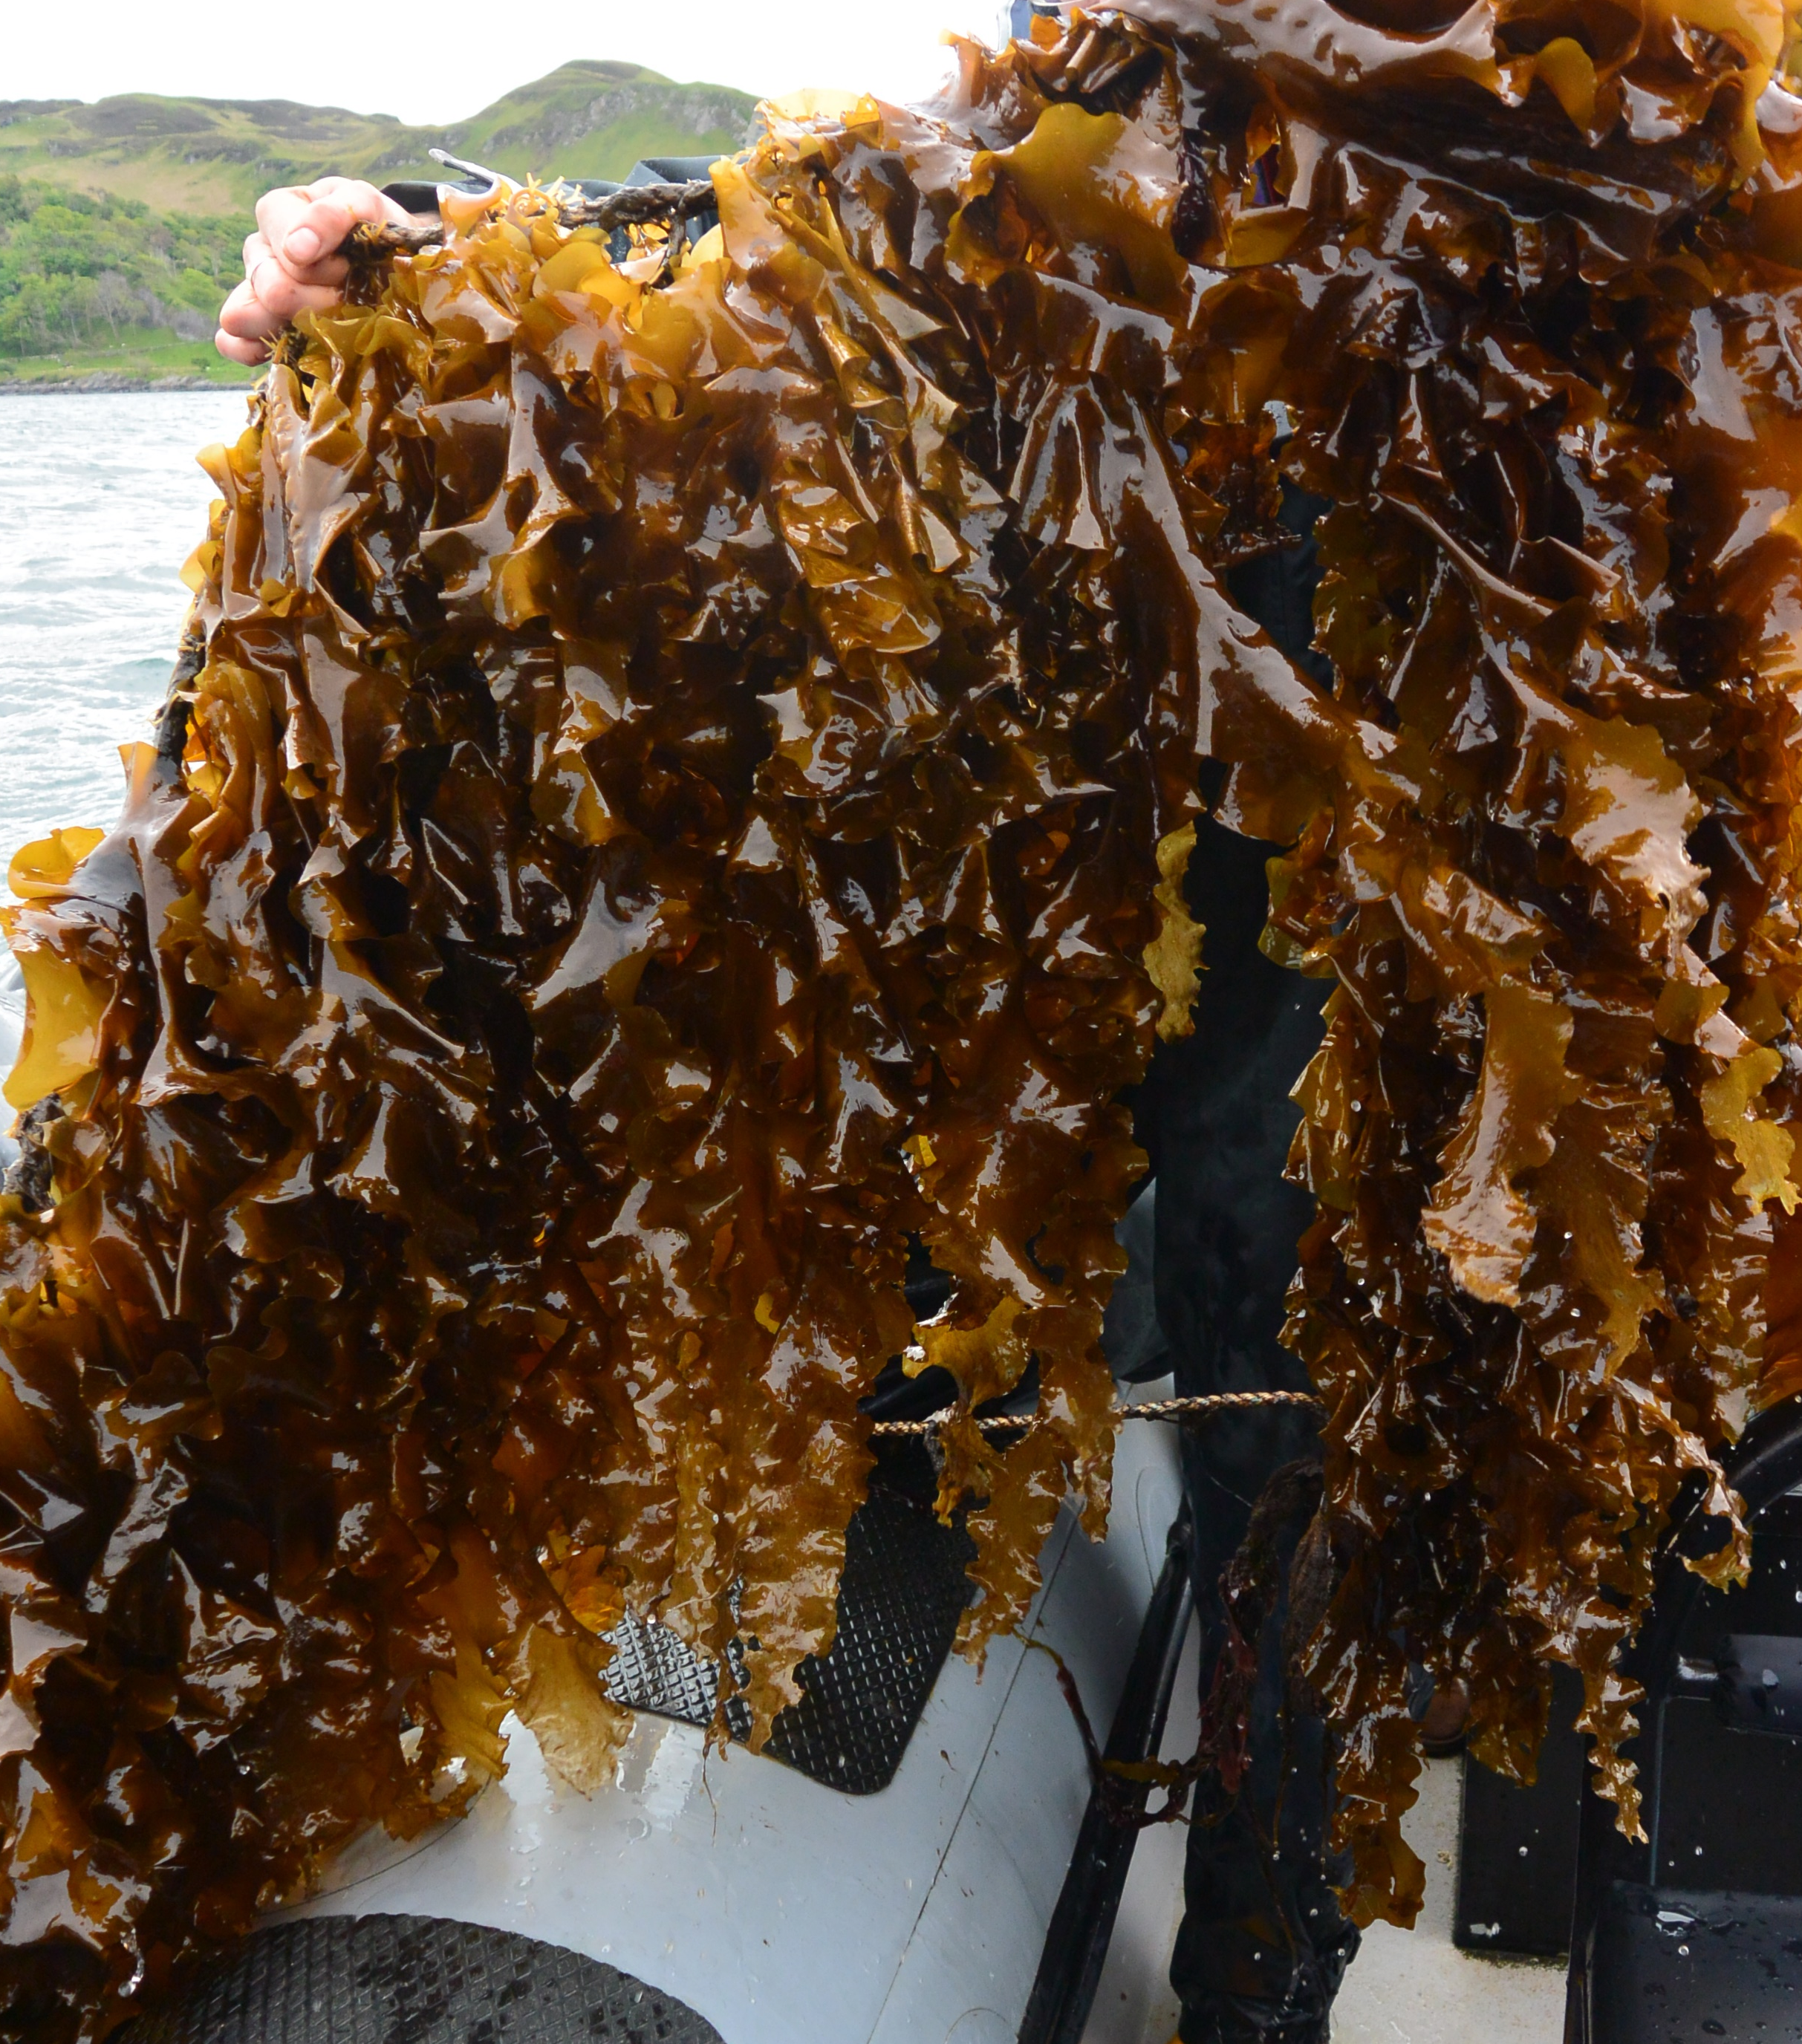
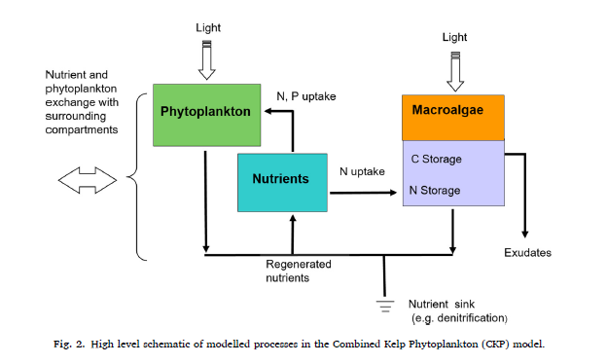
Addressing evidence gaps to inform risk assessment, licensing & aquaculture policy decisions
Modelling growth of farmed seaweed and environmental effects on phytoplankton and mussel production.
Applicable to farms in different locations; output relevant for industry and regulators.
Aldridge et al. 2021, Aquaculture 536, 736400

Slide 10
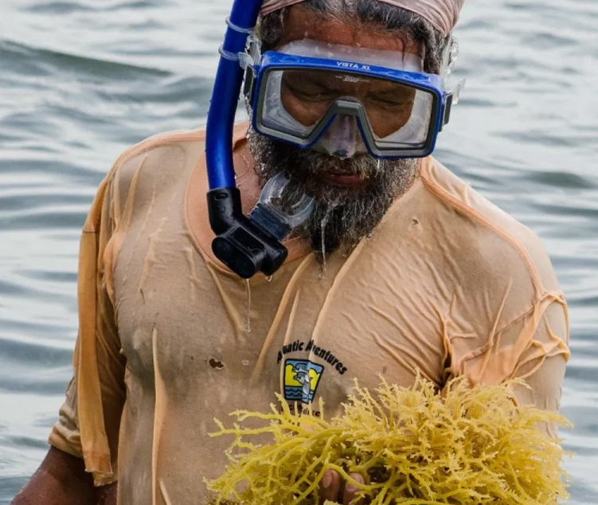
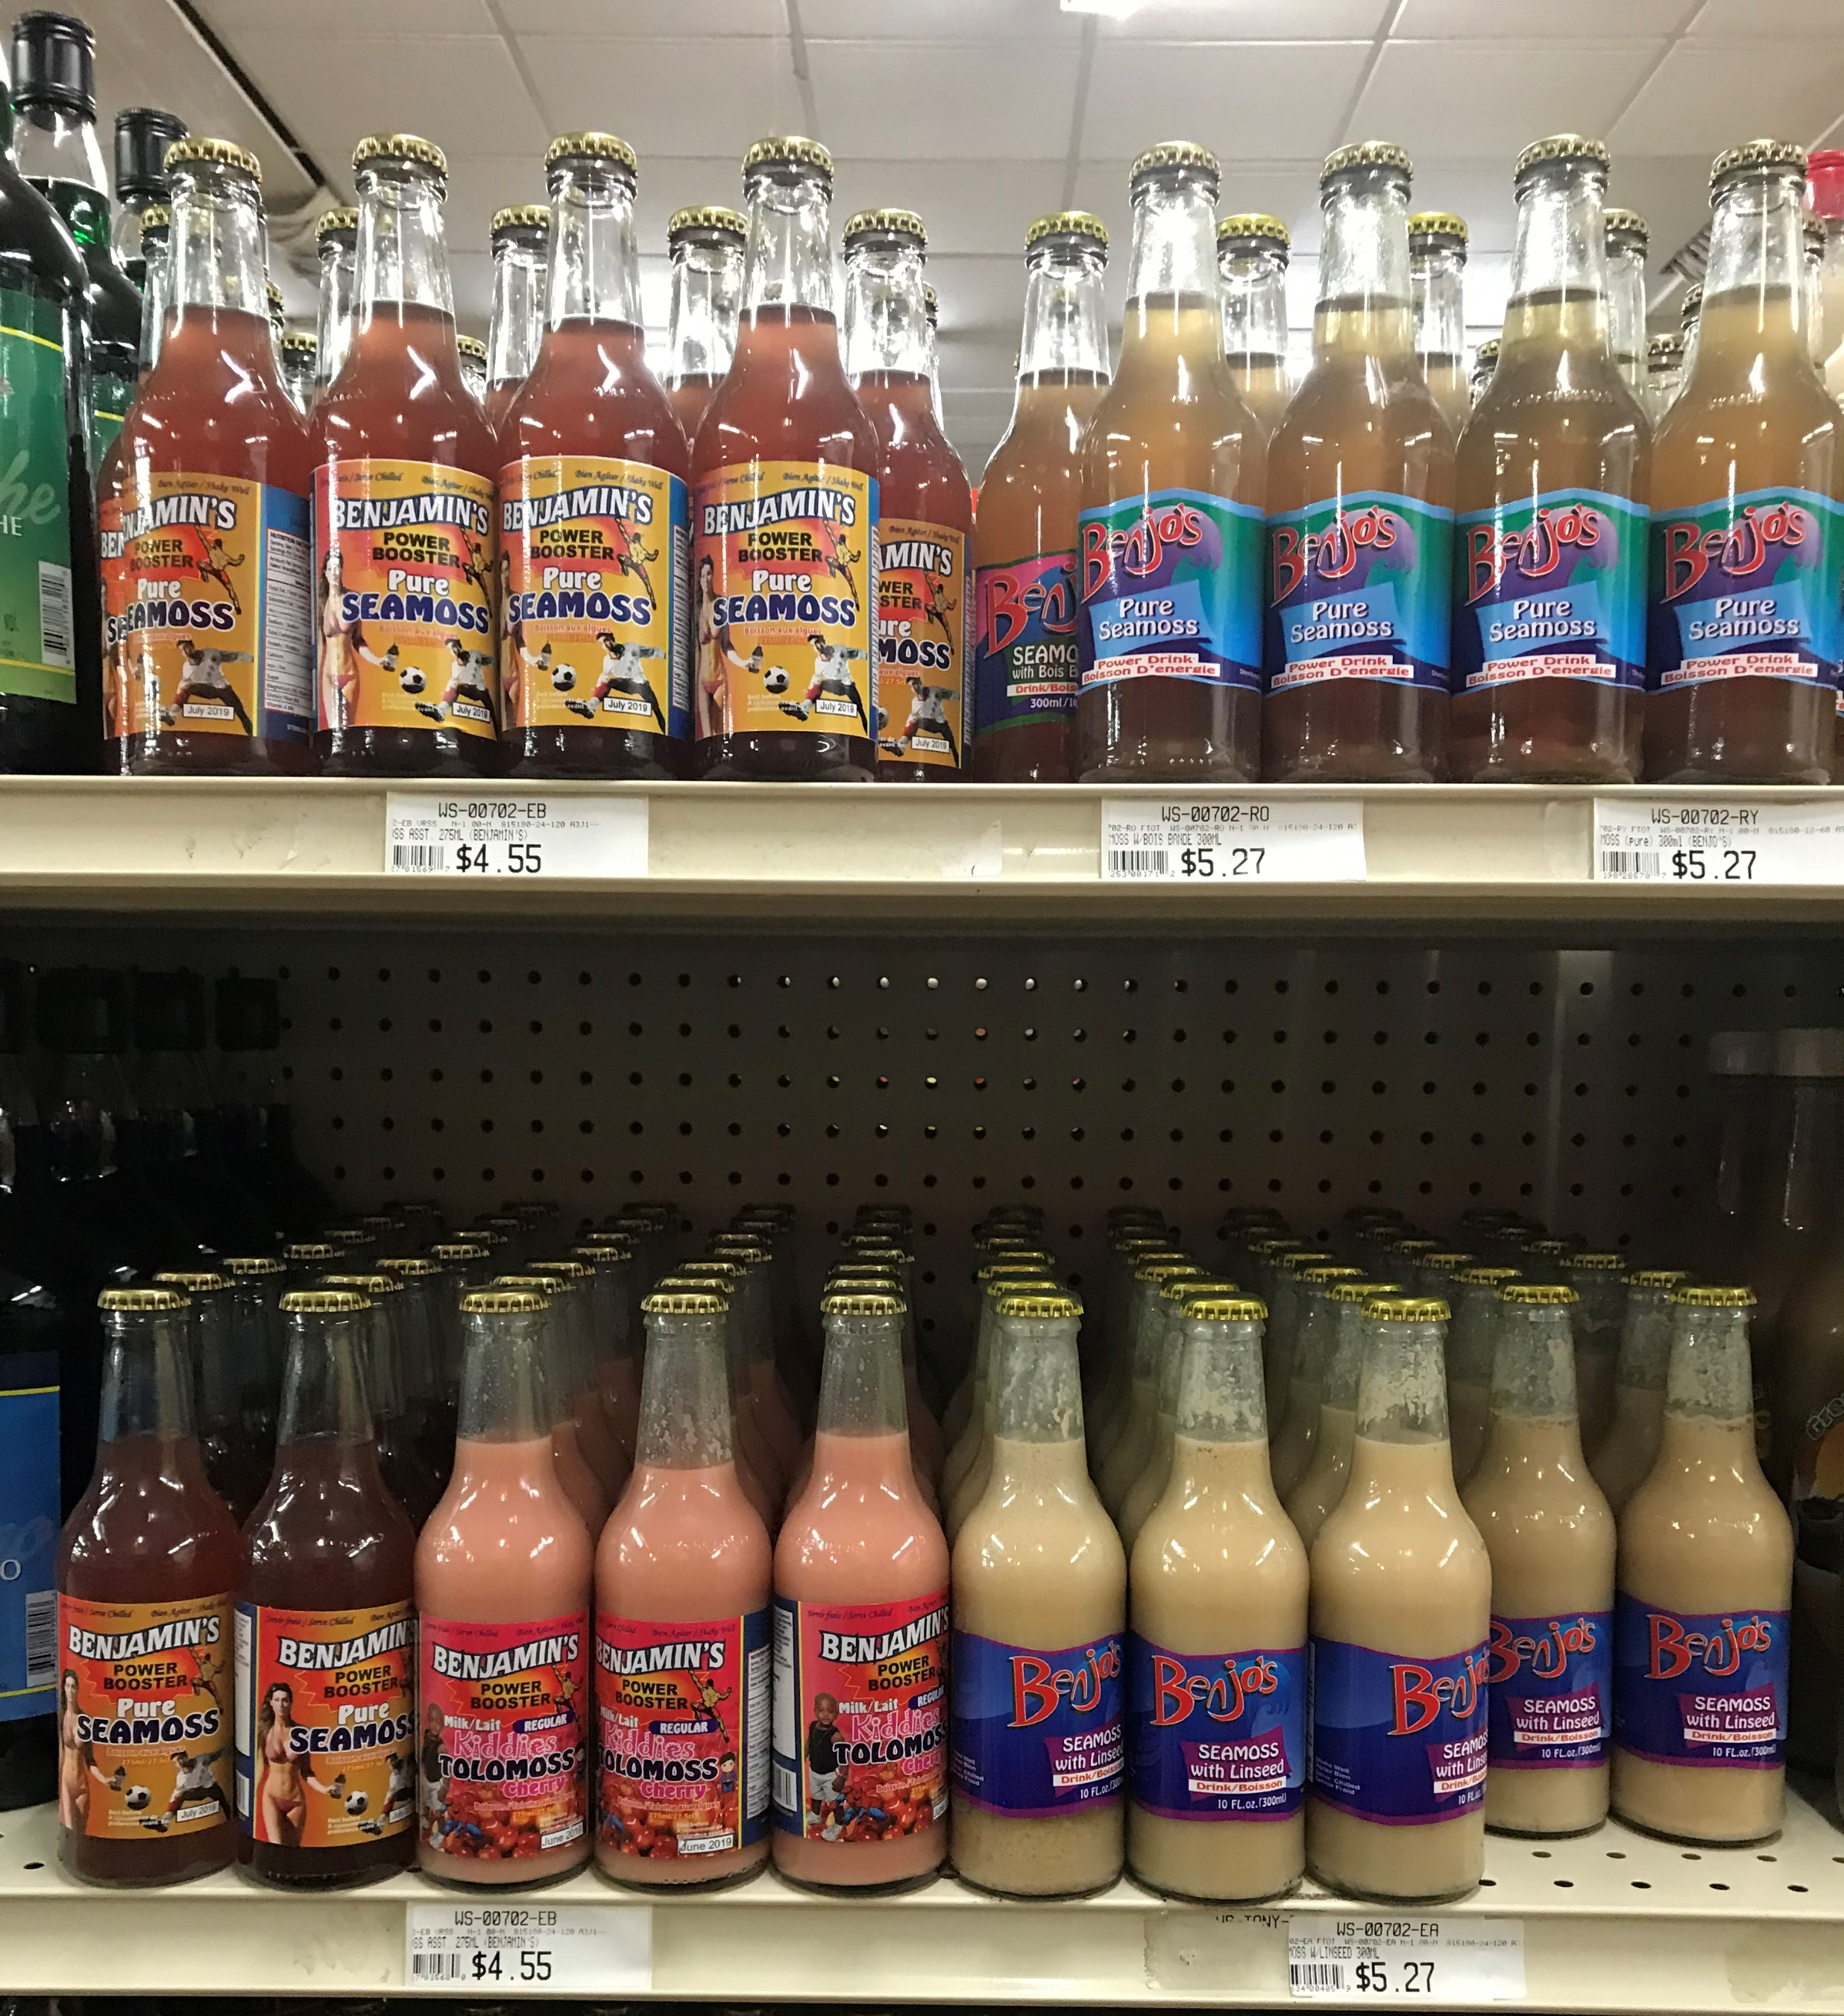
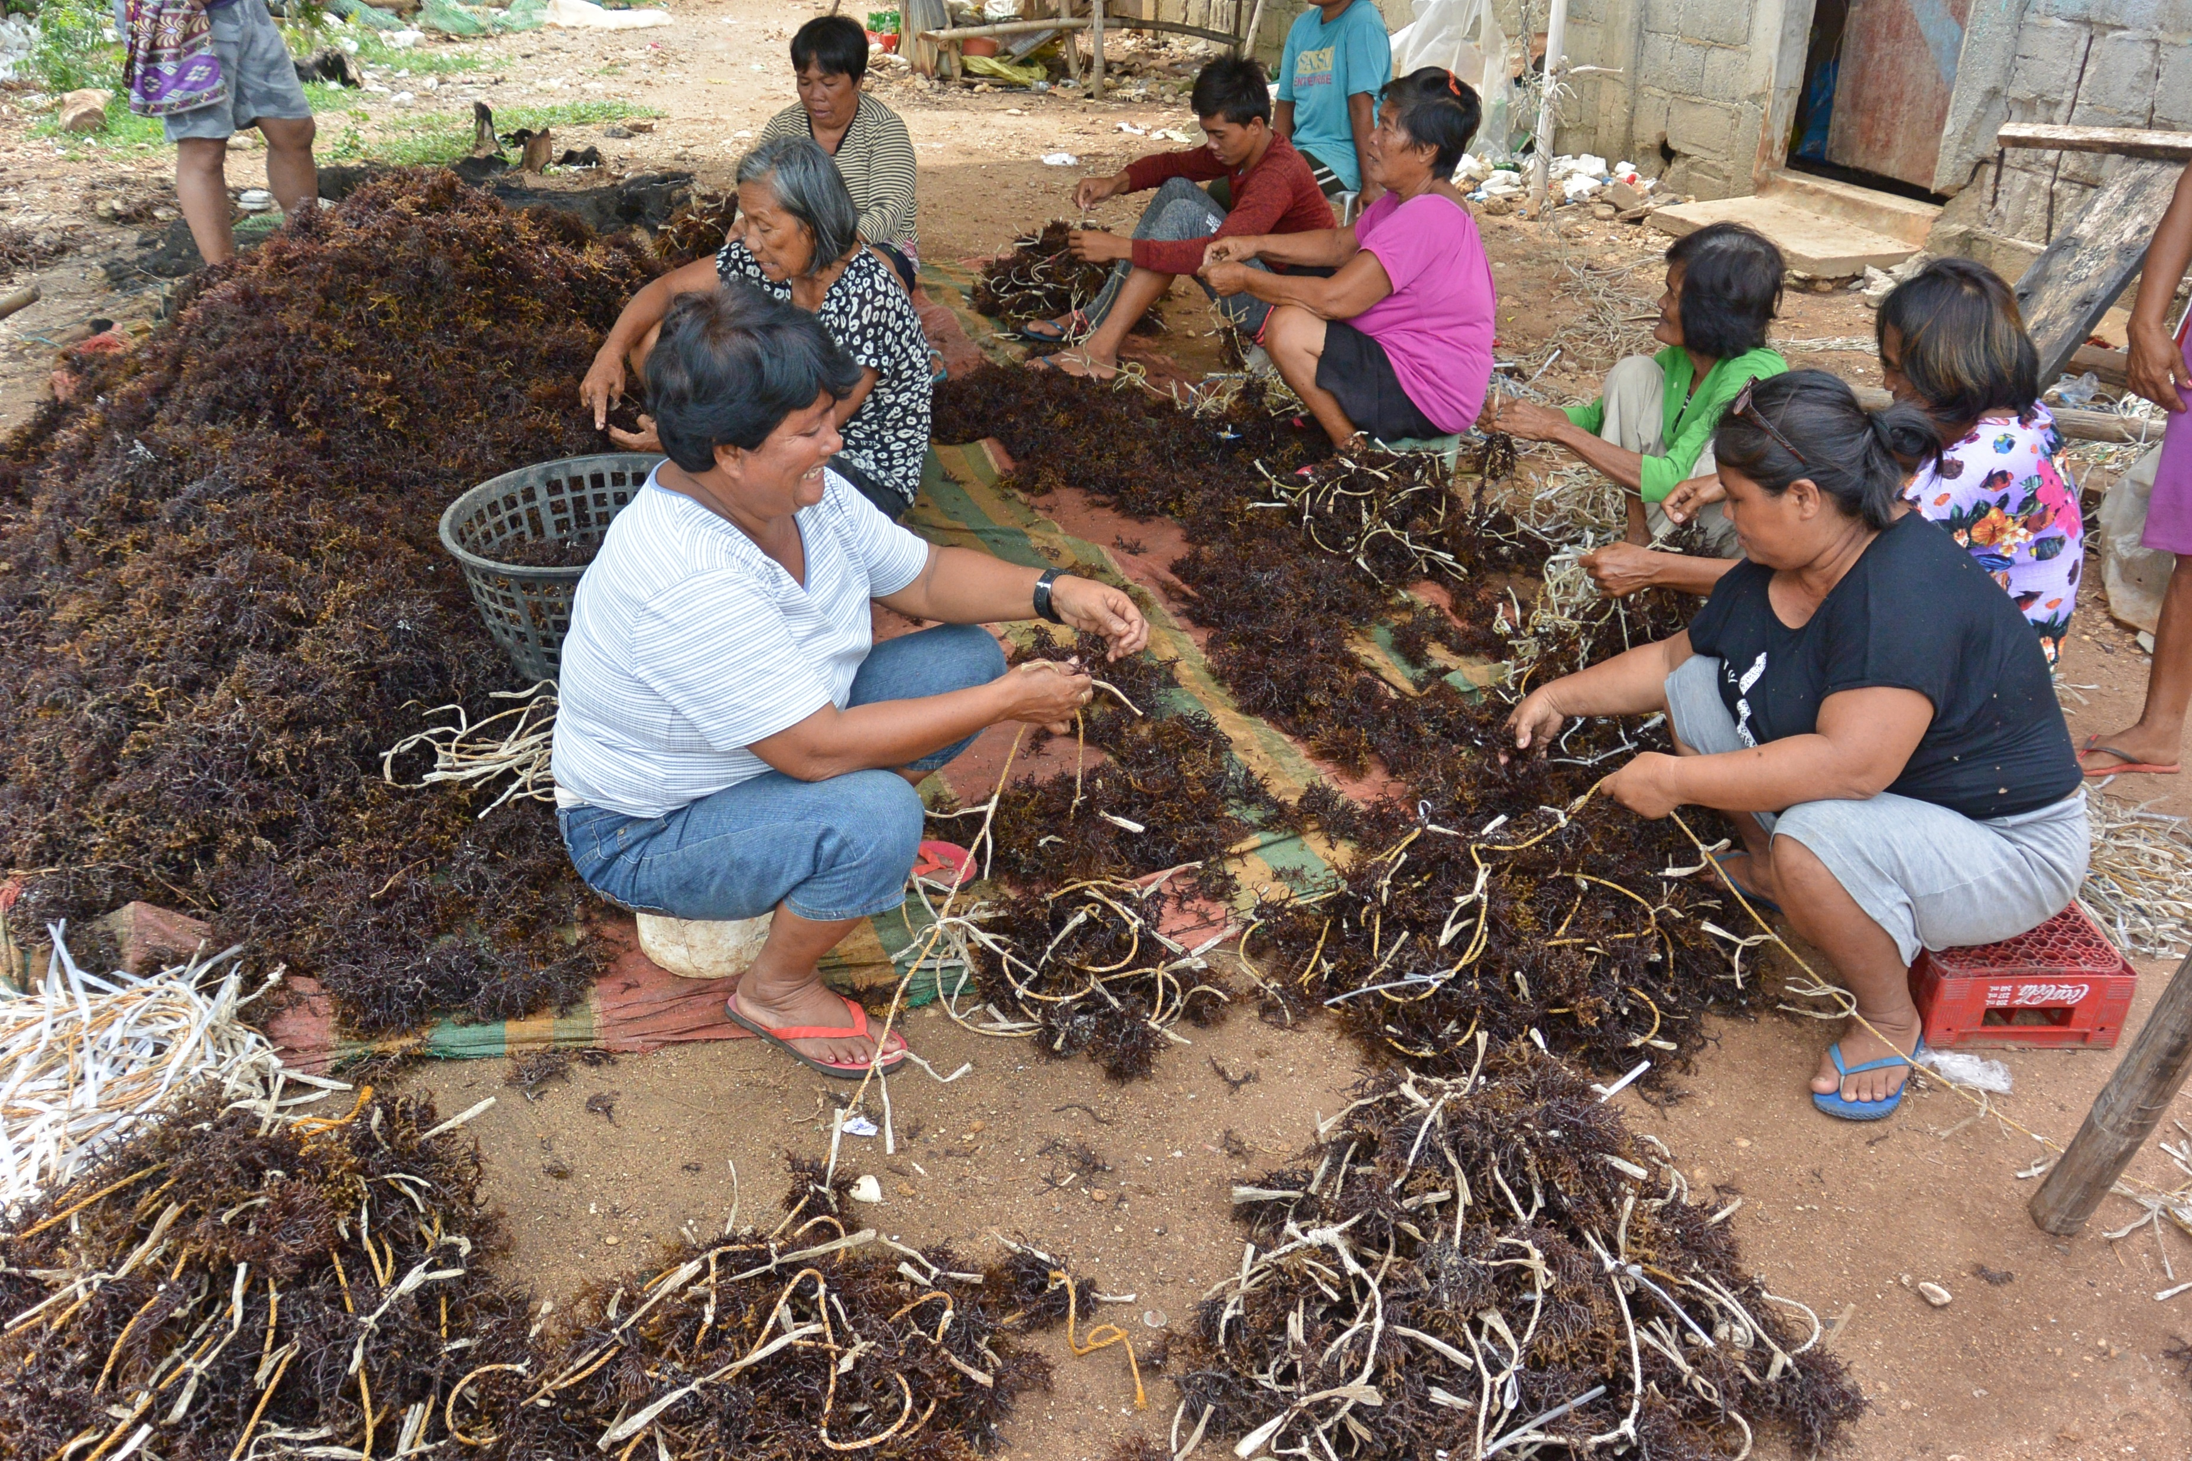
Identifying opportunities, challenges & gender equality in aquaculture
Caribbean
Philippines
Opportunities & challenges in Belize & Dominica to develop seamoss aquaculture.
SWOT analysis, stakeholder interviews & recommendations for industry development.
Investigation of participation, gender division of labour and pay gap in seaweed farming (Kappaphycus sp.) in Bantayan.
Contribute to understand female empowerment through aquaculture & formulation of sound gender sensitive policies.
https://tastebelize.com/2019/09/belizes-incredible-edible-seaweed/
Photo by John Pinnegar
Mengo et al. 2021, Commonwealth Marine Economies Programme
Mengo et al. 2021, in prep

Slide 11
Thanks for your attention elisa.capuzzo@cefas.co.uk @dictioca
Colour | Hex code
 | CCEAF2
 | B2CCD3
 | 83B4C0
 | 57D5FF
 | 48C0EC
 | 00C3F8
 | 00B2E1
 | 007493
 | 005166
 | 000A2E

